Slide 1

#RollingScopes

Slide 2


Dzmitry Varabei aka “Dean”
9+ years of Software Development in EPAM
7 years in education and knowledge sharing as CDP/RD trainer
3 years in community building
Dzmitry Varabei
Chief Software Engineer

Slide 3
"The Rolling Scopes" - a non-profit JavaScript/Front-end community

Slide 4
Our Scope
HTML
CSS
JS
Node.js

Slide 5
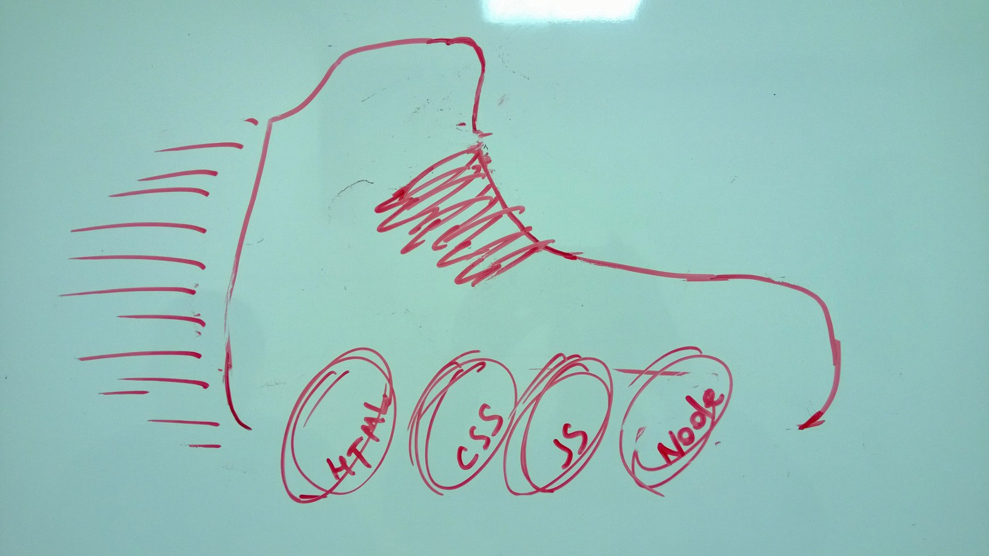

HTML
CSS
JS
Node.js

Slide 6

Design #1

Slide 8
4 years ago…

Slide 9
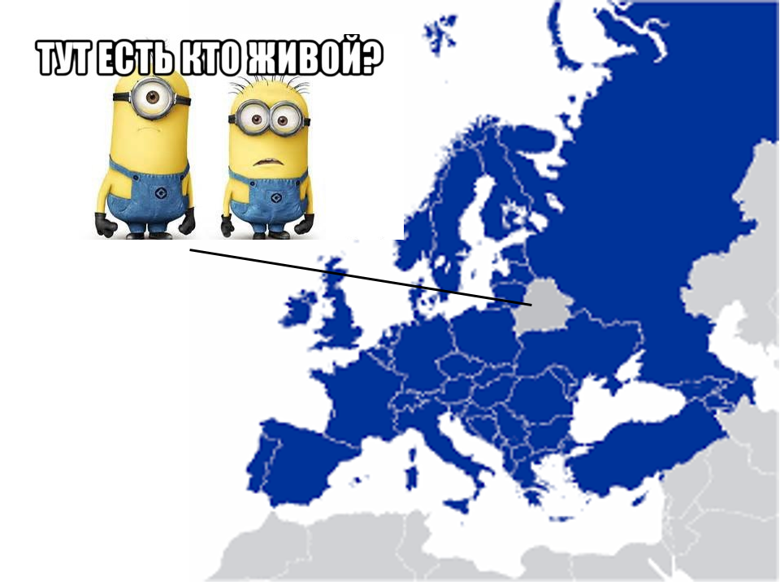

Slide 10
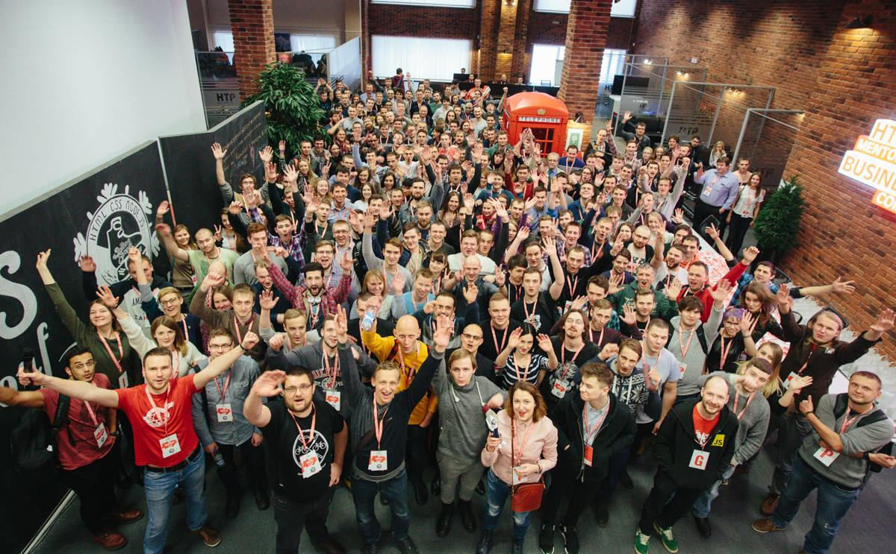
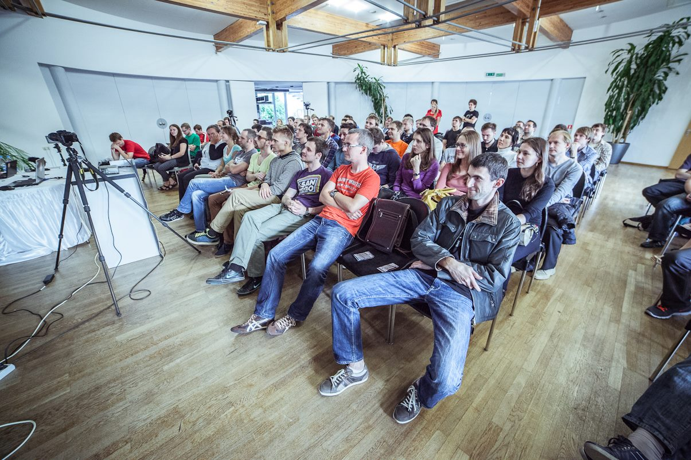
RSConf 2 Workshops 10+ Events 35+ Speakers 85+ Talks 150+

Slide 11
The Rolling Scopes meetups
Minsk
Brest
Gomel
Krakow
Gdansk
What's
next?

Slide 12
Grodno!!!

Slide 13
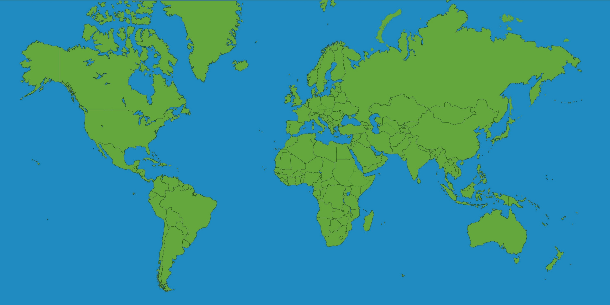


RS everywhere!

Slide 14

Speakers wanted!
All the time!

Slide 15
Topics?
FRP
React
Tools
Best Practices
Browser internals
HTML5 Api
UX
CSS3
Racing drones
IoT
Blockchain
Virtual Reality
Psychology
Angular 2

Slide 16
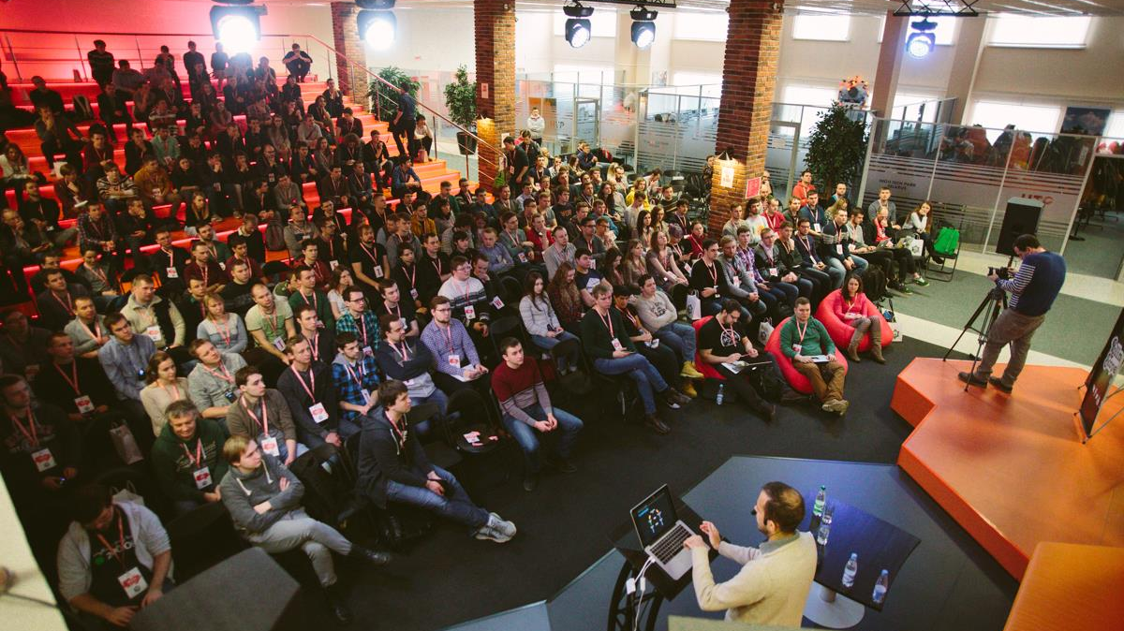
THE ROLLING SCOPES CONFERENCE 2016

Slide 17
The Rolling Scopes Conference 2017
18 – 19th February 2017, Minsk

Slide 18
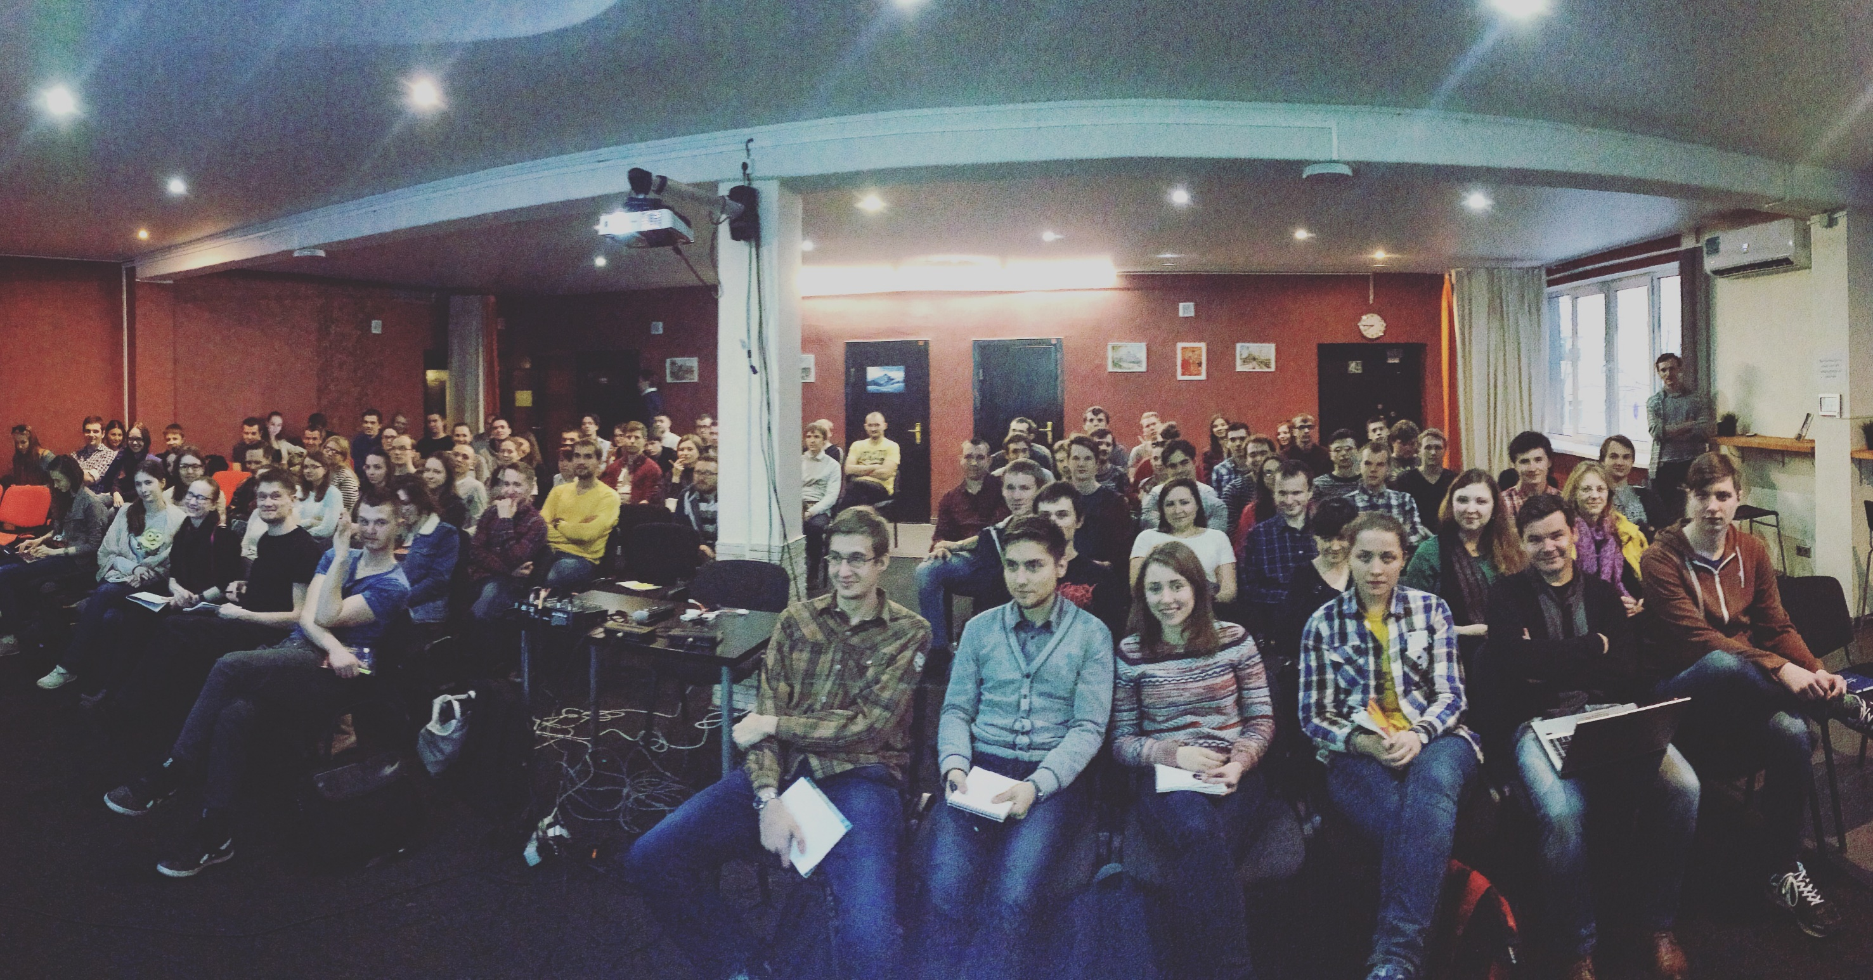
The Rolling Scopes School
120+ hours
~20 trainers
~60 attendies
6 cycles already passed

Slide 19
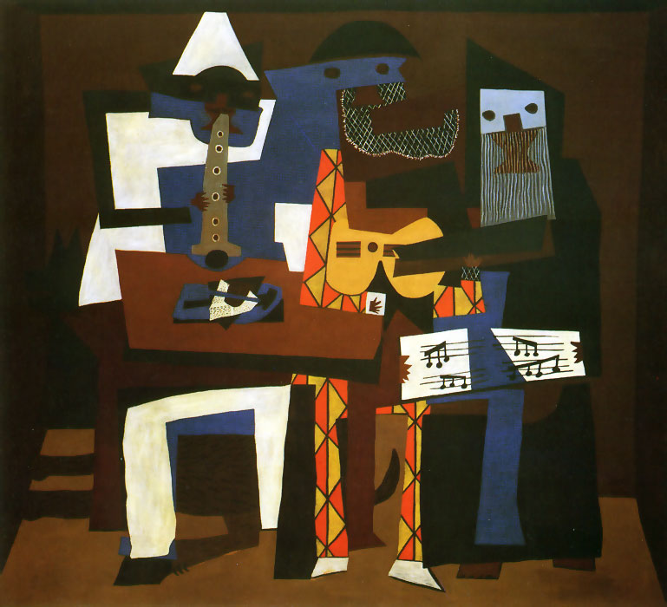

Slide 20



Slide 21


Slide 22
The Rolling Scopes School
Next loop - January 2017

Slide 23
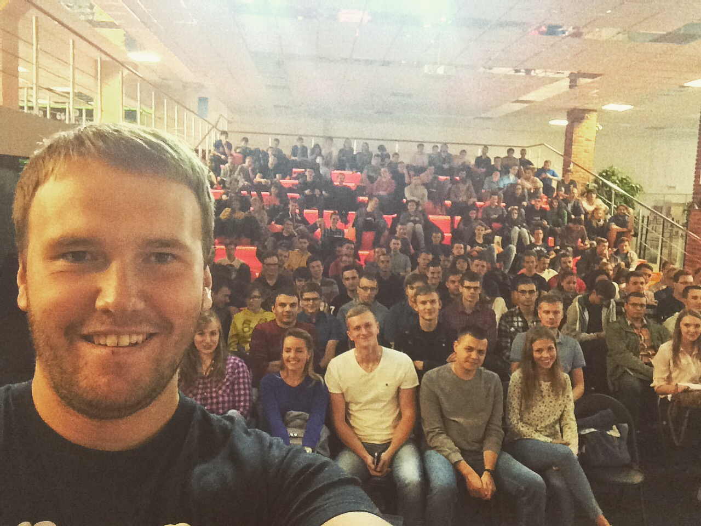
300

Slide 24
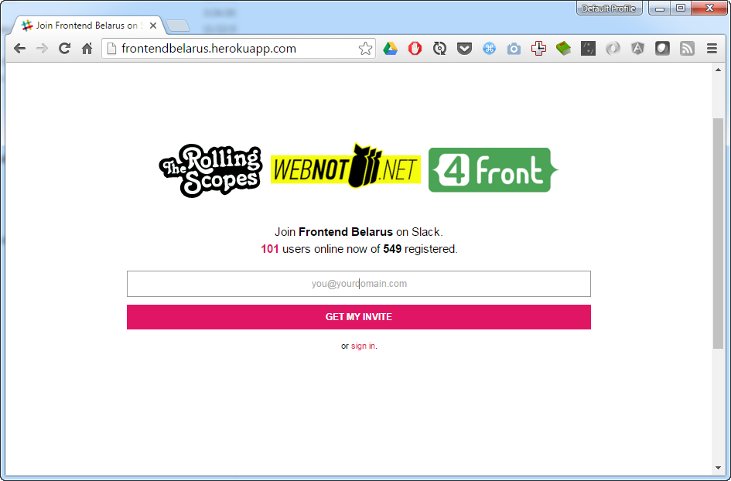
http://frontendbelarus.herokuapp.com/

Slide 25
https://rollingscopes.com/

Slide 26
Thank you!

Slide 27



Contact me
Dzmitry_Varabei@epam.com
Dzmitry_Varabei
https://www.facebook.com/dzmitry.varabei
Notes:
Text should be left aligned / icons should be broken into two columns three and three

Slide 28
The most interesting facts…

Slide 29
World Usability Day
12th November 2017, Minsk

